Slide 1
Texas Traffic Trends
Stops and Accidents from 2010 to 2018

Slide 2
The Data
Crash Records Information System (C.R.I.S)
TxDOT Crash Query Tool
https://cris.dot.state.tx.us/public/Query/app/public/welcome
2010-2017
Stanford Open Policing Project
https://openpolicing.stanford.edu/data/
2010-2017

Slide 3
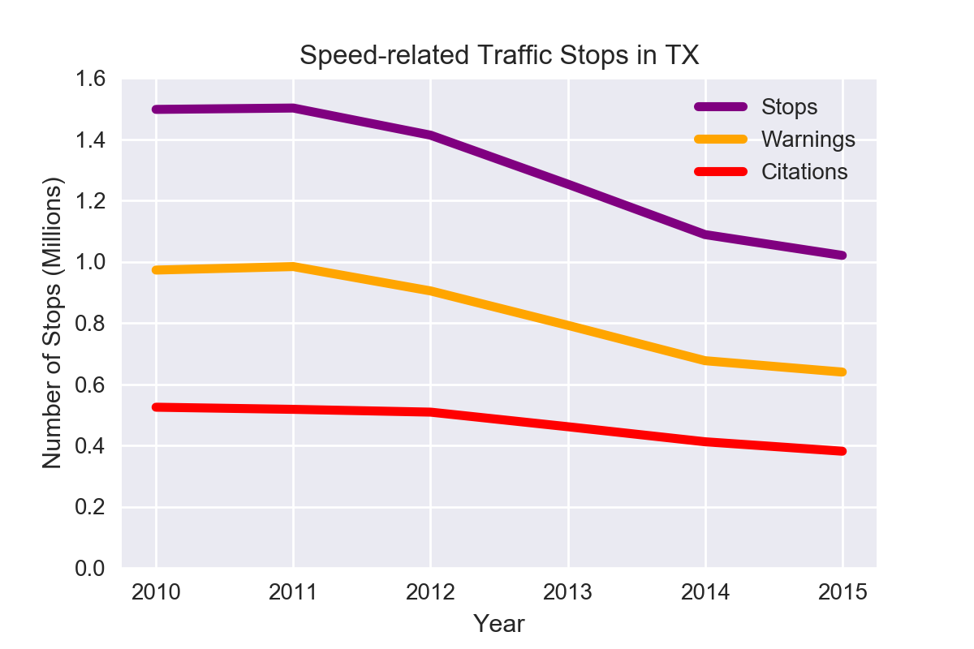
Stopping Speeders
Overall, traffic stops citing speed as a reason for the stop have decreased by about 30%
While the number of warnings given out as a result has decreased at a similar rate (slightly over 30%), the number of citations given has seen a much smaller drop, by only around 20%

Slide 4
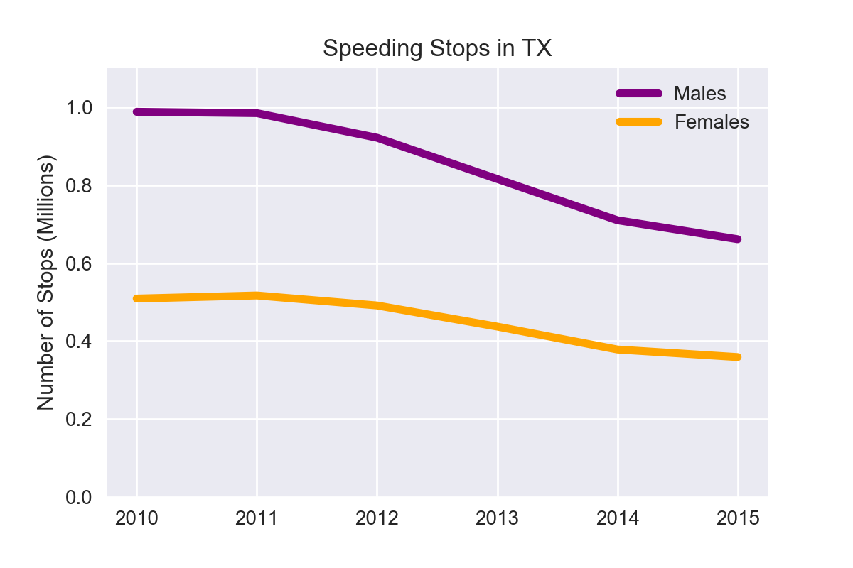
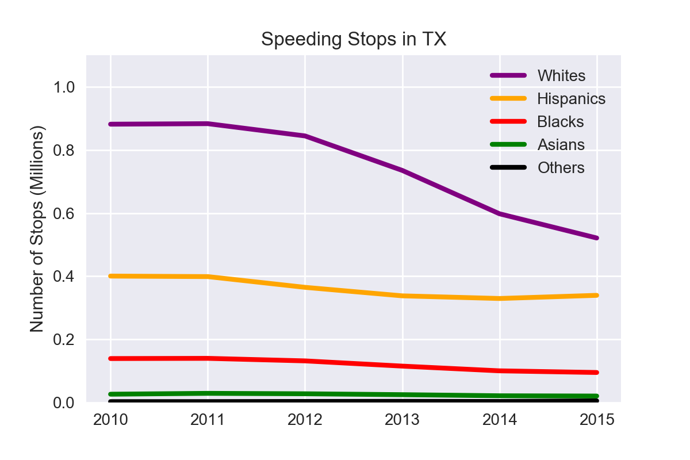
Stopping Speeders
While men saw a slightly larger drop in number of speeding stops than women, the sharpest discrepancy is apparent in the racial breakdown, where we can see that minorities races remain relatively consistent in their number of stops while slightly more than half as many white people were stopped in 2015 as in 2010.

Slide 5
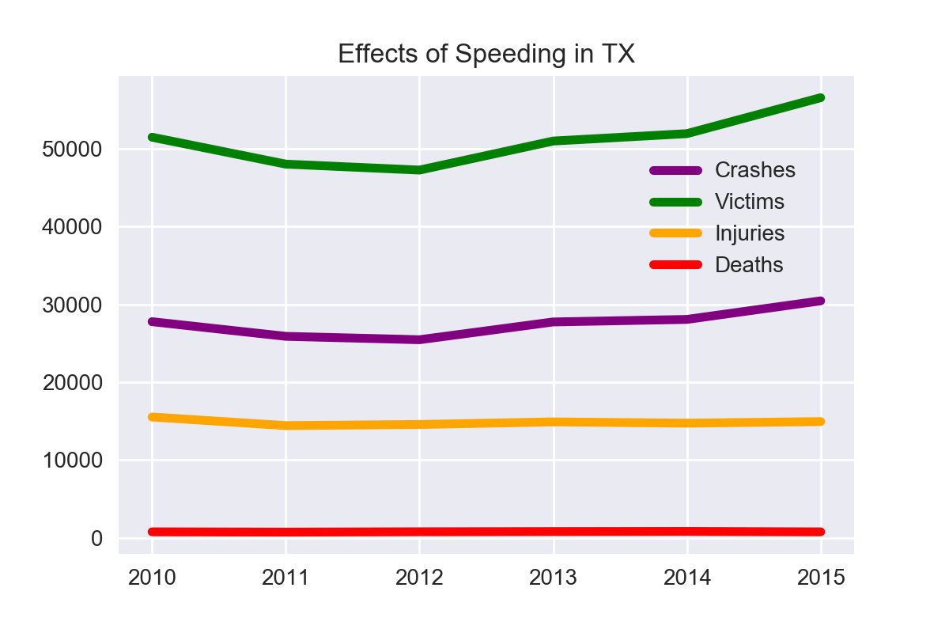
Stopping Speeders
While the number of injuries and deaths due to accidents where speed was a factor remained relatively stable, there is a clear upwards trend on the number of accidents and victims involved.
Further research into other states might support or refute an inverse relationship between number of warnings given out and minor accidents (without injury).

Slide 6
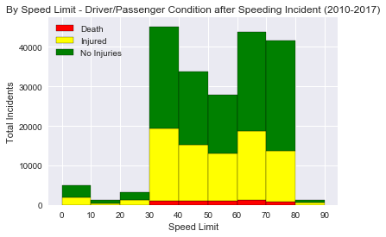
Pushing the Limits
There is a dramatic increase in both accidents and their fatality as soon as the posted speed limit hits 30 MPH.
Comparing these numbers with each speed limit’s total road miles within Texas could help identify any particularly deadly speed limits.
Data Source: C.R.I.S 2010-2017

Slide 7
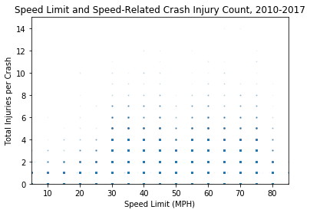
Pushing the Limits
While the majority of speed-related crashes did not involve injury, areas with a posted speed limit under 30 MPH very rarely saw accidents with more than two injuries, with another dramatic increase at limits of 30 or higher.
Data Source: C.R.I.S 2010-2017

Slide 8
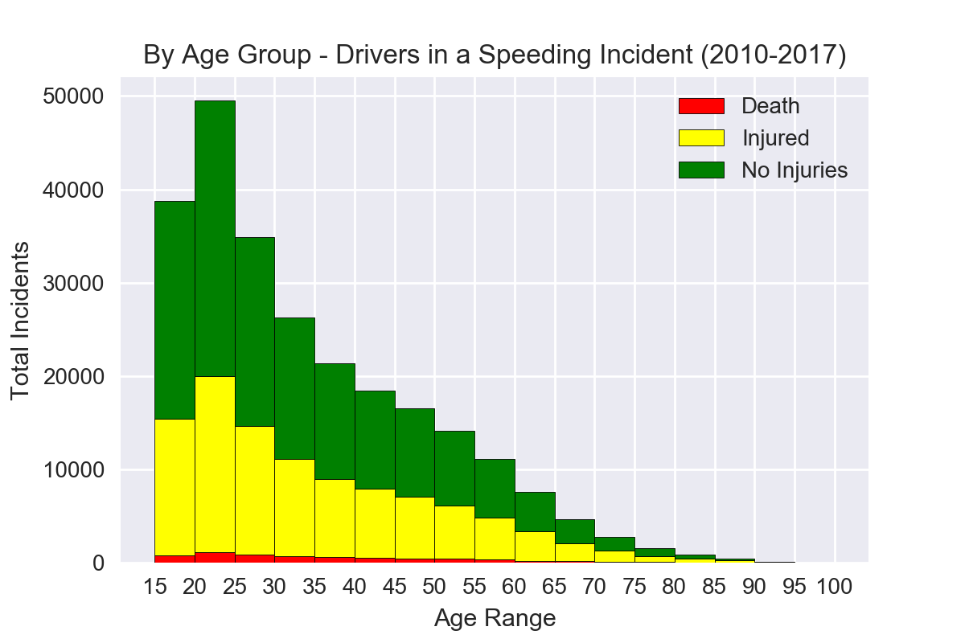
Slowing Down with Age
Drivers involved in speed-related crashes overwhelmingly tend to be under 30, with the peak range from 20-25 years old.

Slide 9
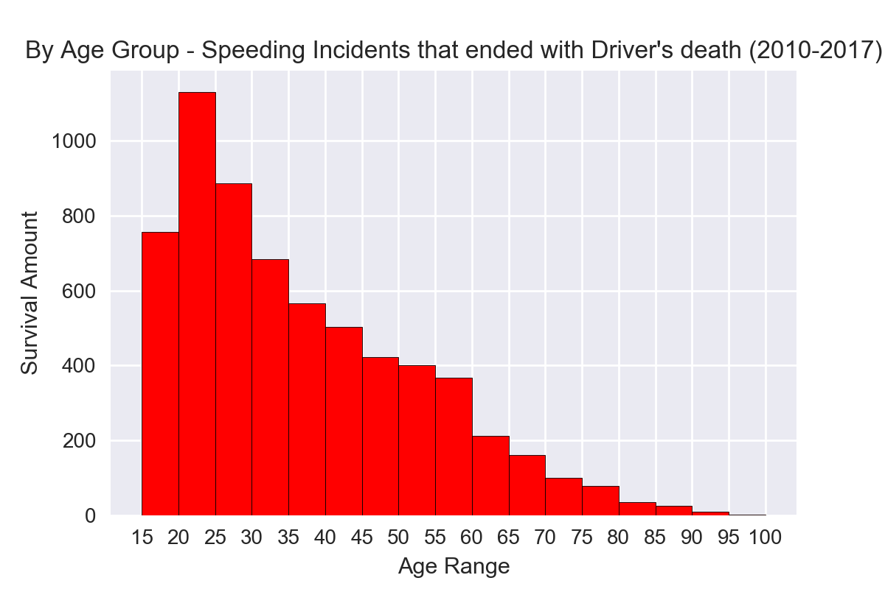
Slowing Down with Age
When focused on driver deaths, however, drivers under 20 seem to be less likely to lose their life than other age groups when involved in speed-related accidents

Slide 10
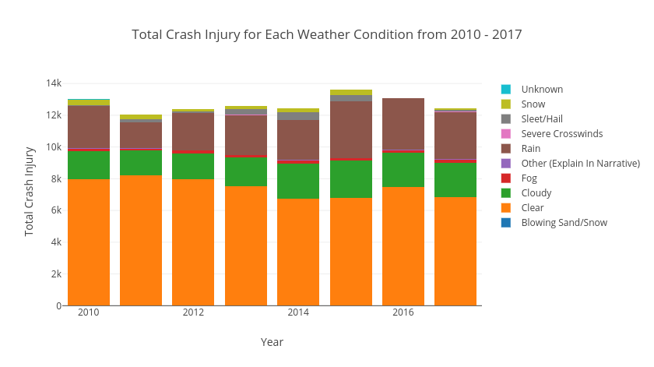
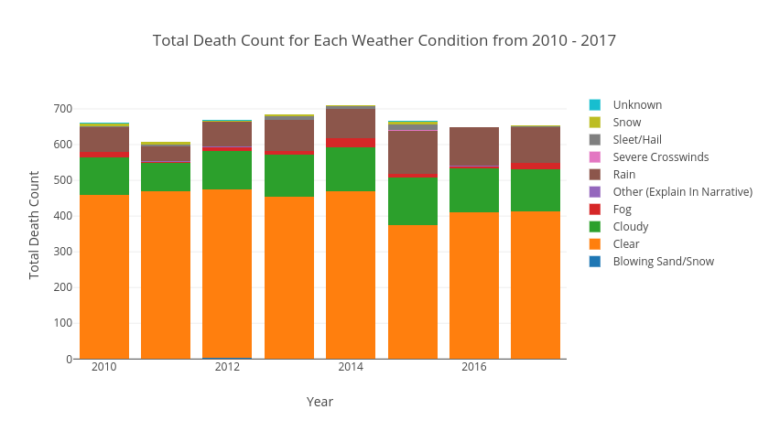
Under the Weather
While the majority of accident injuries/deaths occur on a clear day, there are more injuries recorded on rainy days than cloudy.
Comparing this breakdown to the proportion of clear, cloudy, and rainy days throughout each year could support or refute the statistical significance of this.

Slide 11
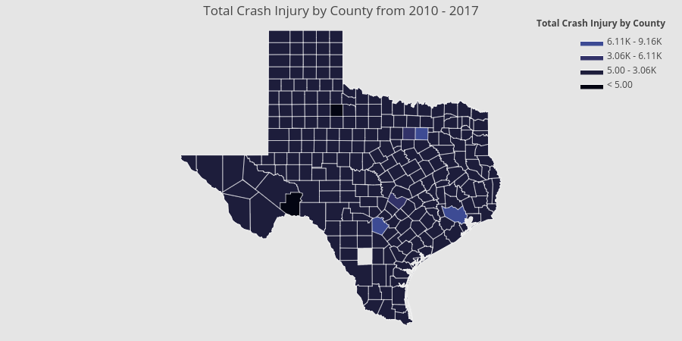
Under the Weather
This heat map shows that the highest concentration of injuries from traffic accidents takes place around the metropolitan areas of Houston, Dallas, and San Antonio.

